Slide 1
Exploring Carbon-bearing Matter in an Antarctic Micrometeorite
Victoria Froh^{1,2,3} and Maitrayee Bose^{1,3}
¹School of Earth and Space Exploration, ²School of Molecular Sciences, ³Center for Isotope Analysis
Arizona Space Grant Symposium – 4/17/21

Slide 2
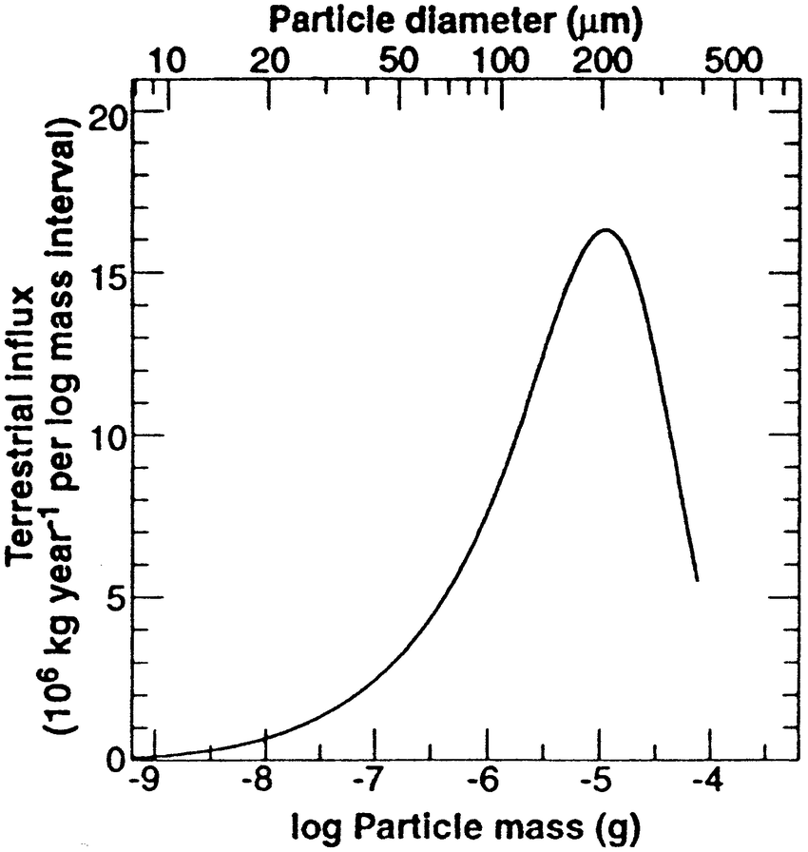
Importance of Micrometeorites
40,000 + 20,000 metric tonnes/year¹
< 10% reaches surface (2700 + 1400)²
Meteorites: 53.8 tonnes/year³
50x micro>meteorites
Micrometeorite organics: possible sources of Earth’s biocritical elements
Carbon isotope composition and content in micrometeorites has not yet been constrained
Source: Binzel, R., Hanner, M., & Steel, D. (2000). Solar System Small Bodies. Allen's Astrophysical Quantities.
1: Love, S. G., & Brownlee, D. E. (1993). Science, 262(5133), 550-553. 2: Taylor, S. et al., (1998). Nature 392, 899-903. 3: Zolensky, M. et al. (2006) Met. and the early sol. sys. II 943 4:

Slide 3
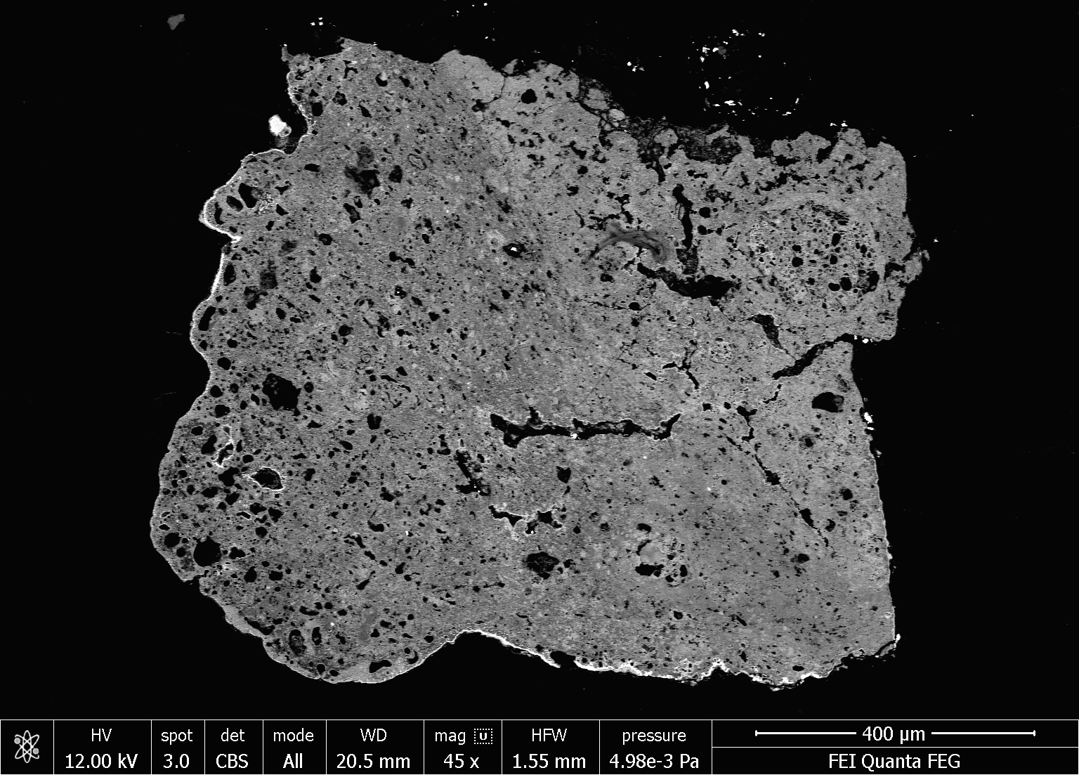
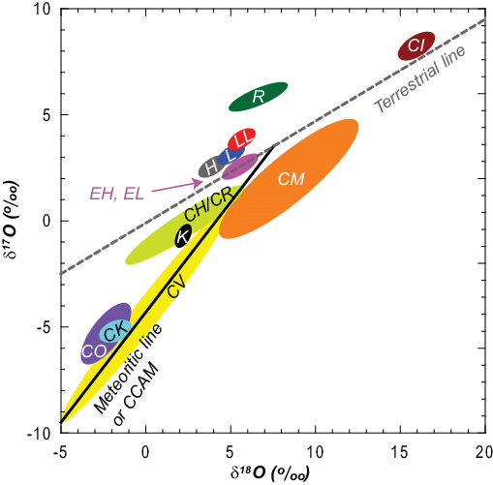
TAM19B-7
Source: Martin Suttle
Source: Doh, Seong-Jae & Yu, Yongjae. (2010). Journal of The Korean Astronomical Society 43. 183-190.

Slide 4
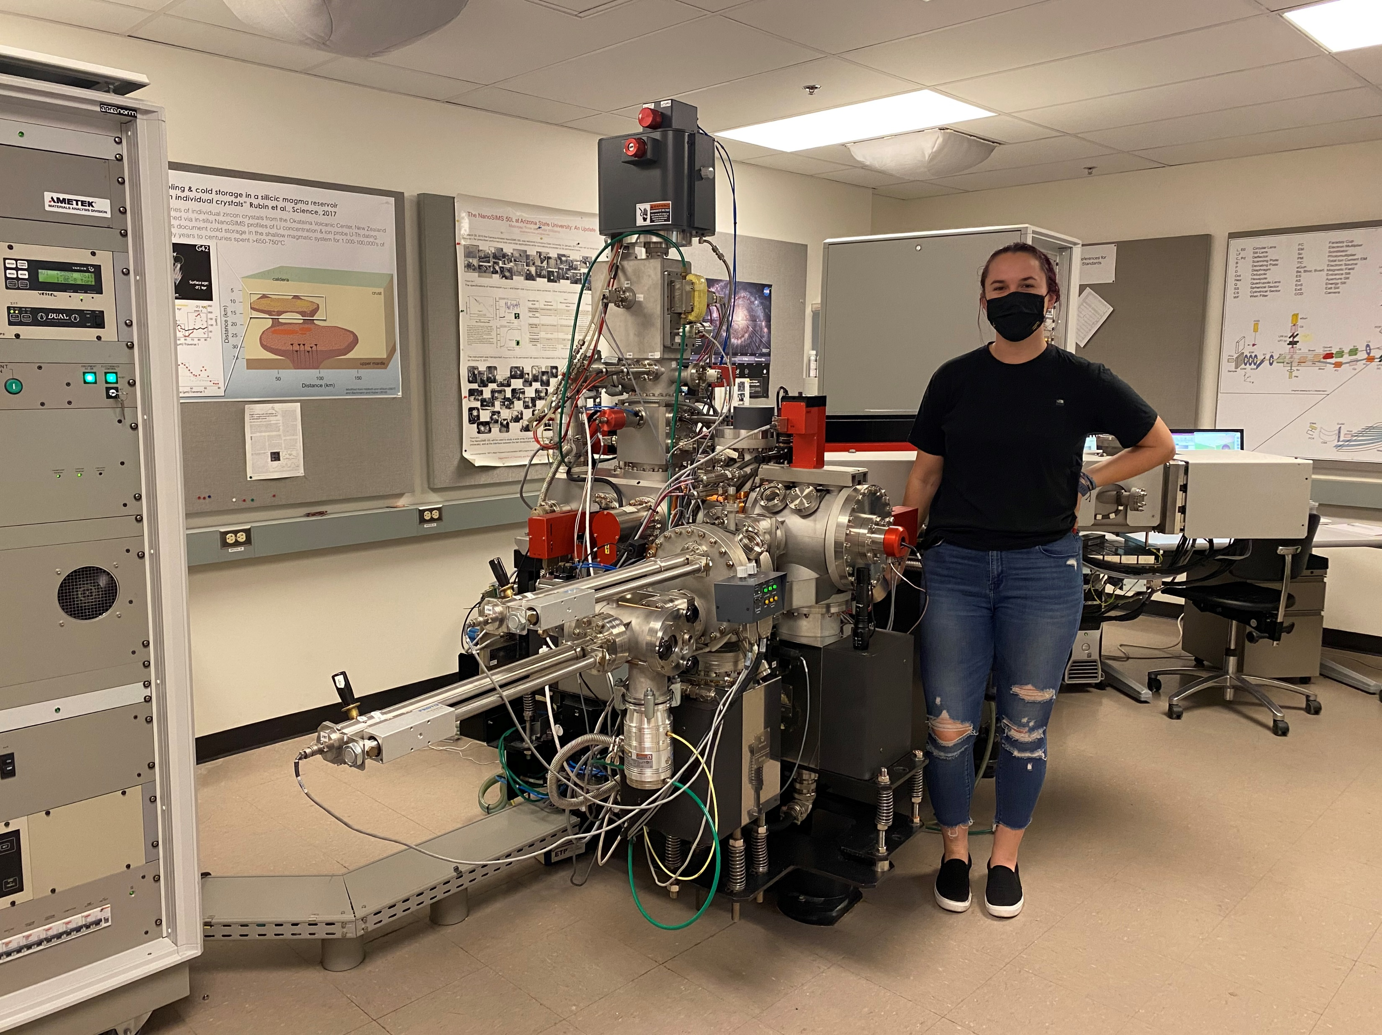
NanoSIMS Measurements
ASU’s NanoSIMS 50 L Instrument
16 keV Cs⁺ ion beam,5pA 5x5 μm² measure
Measured ¹²C⁻, ¹³C⁻, ²⁸Si⁻
Standards: cyanoacrylate (“Crazy-Glue”), epoxy resin

Slide 5
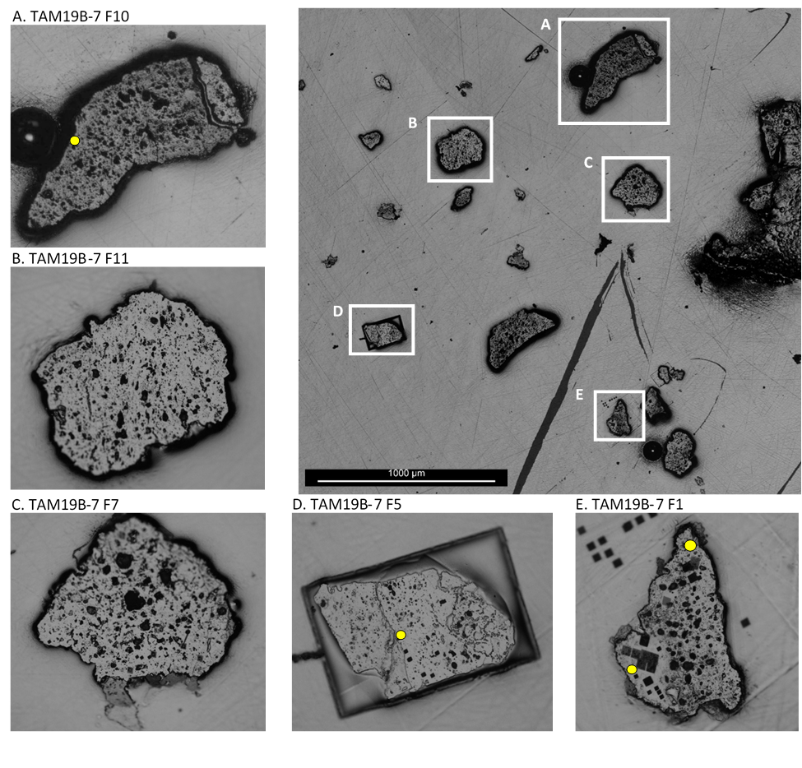

Slide 6
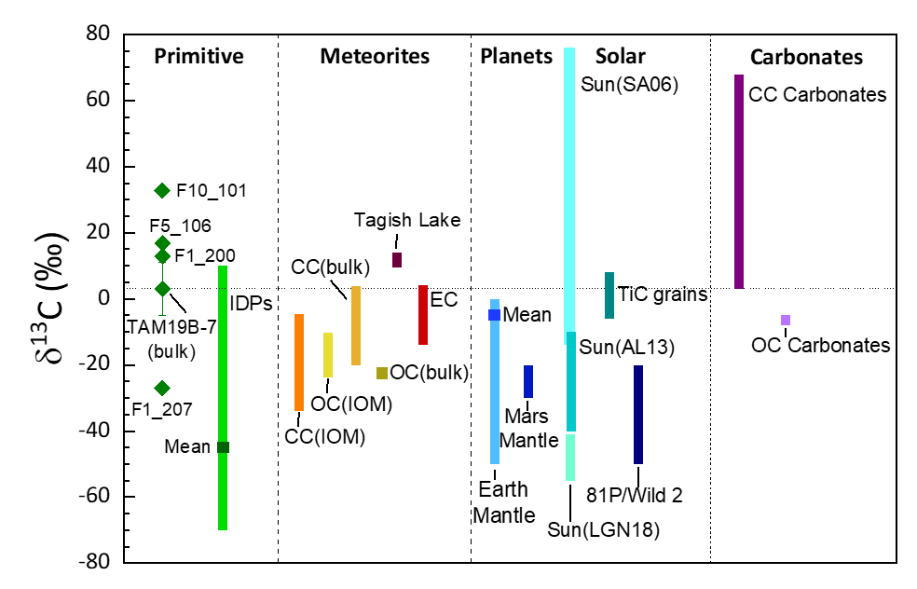
Data Source: Lyons, J. R., Gharib-Nezhad, E. & Ayres, T. R. (2018). Nature communications, 9(1), pp.1-10.

Slide 7
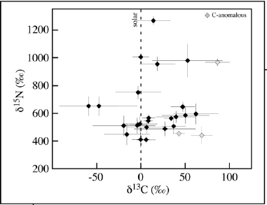
Possible Carrier Phases
Carbonaceous material
Source: Bose et al. (2012) Geochim. Cosmochim. 93, 77-101

Slide 8
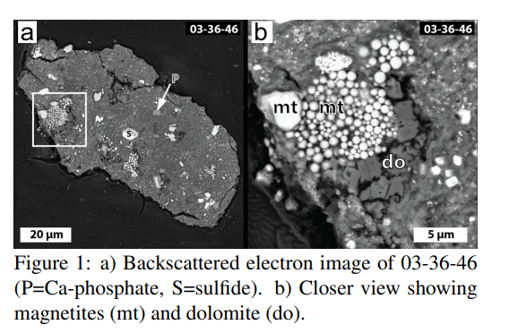
Possible Carrier Phases
Carbonaceous material
Carbonate Grains
Source: Ogliore R.C. et al (2019) LPSC L Abstract #2778

Slide 9
Conclusions
¹³C Enrichment of the bulk (3‰) is unusual
Possibility of new, ultrahydrated parent body
If carbonates: dating of the Mn-Cr system to look at alteration history

Slide 10
Thank you! Questions?
Special Acknowledgments: ASU/NASA Space Grant and Dr. Martin Suttle

